Slide 1
Lending Club Defaulters Study
Ram
Akaash

Slide 2
Objective of the Case Study
The Objective is to identify risky loan applicants who may default on the loan. Through EDA, we are going to find patterns of defaulters from the past loan applicants data
This study will enable the Lending Club to predict borrower defaults, guiding business decisions and reducing credit losses

Slide 3
Factors of Loan Default
‘dti’ - Ratio of total debt to total income. Higher number could lead to default
'revol_util' - The amount of credit the borrower is using relative to all available revolving credit. A higher ratio could lead to default.
'Home_ownership' - The home ownership status provided by the borrower. Own home owners are likely to close the loan since there is no obligation to pay rent
'open_acc' - The number of open credit lines in the borrower's credit file. Higher number could lead to defaults
'delinq_2yrs' - number of delinquencies in the past 2 years. Higher number could lead to defaults
'emp_length' - Employment length in years. Borrowers with high employment length may tend to default

Slide 4
Exploratory Data Analysis
Histograms have been plotted for the columns below, and univariate analysis has been conducted
dti
revol_util
emp_length
purpose
term
home_ownership
Interest_rate
A box plot has been created for the columns 'employment_length' and 'annual_income'

Slide 5
Exploratory Data Analysis
A heatmap has been plotted for the columns listed below to identify the correlations between them
dti
annual_income
revol_util
emp_length
purpose
term
home_ownership
interest_rate

Slide 6
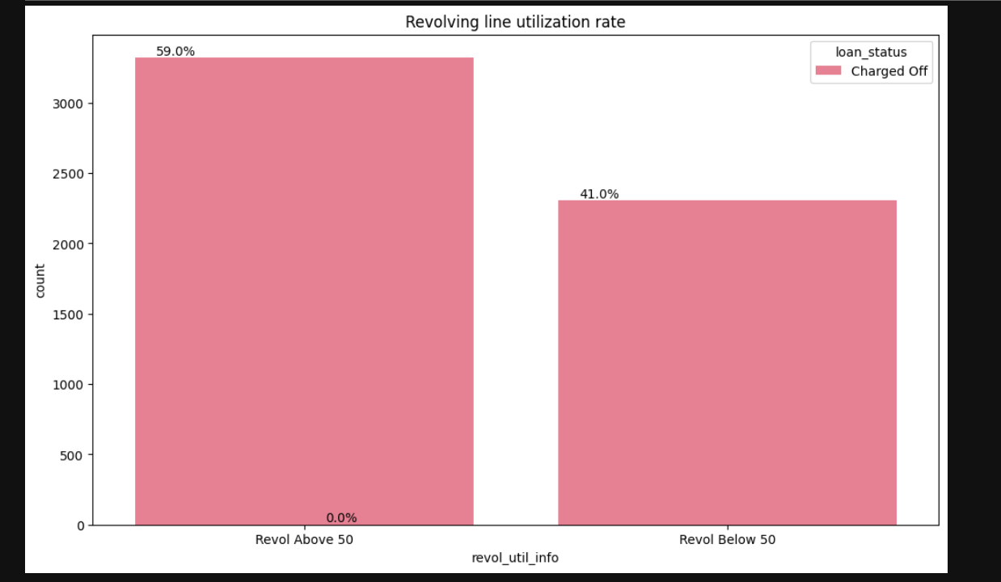
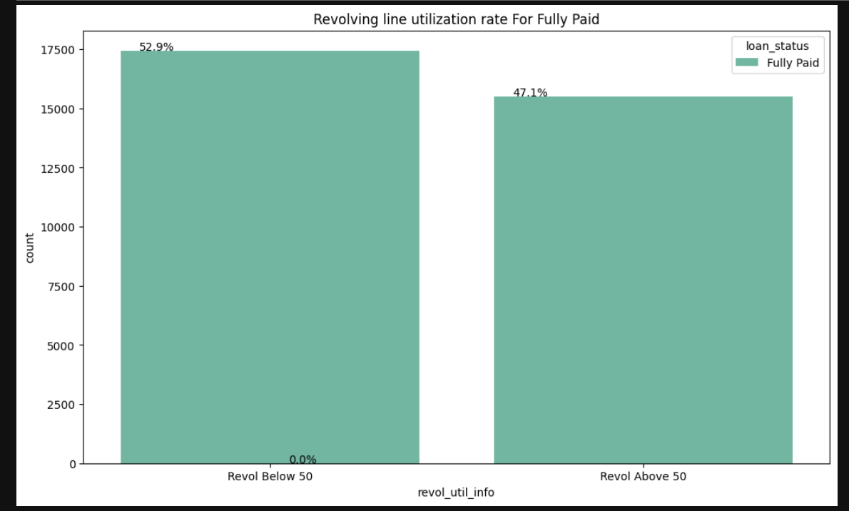
Findings of Loan Default
Insights from ‘Revolving line utilization rate’ - It has been observed that the number of defaults increases when the 'Revolving Line Utilization Rate' exceeds 50%

Slide 7
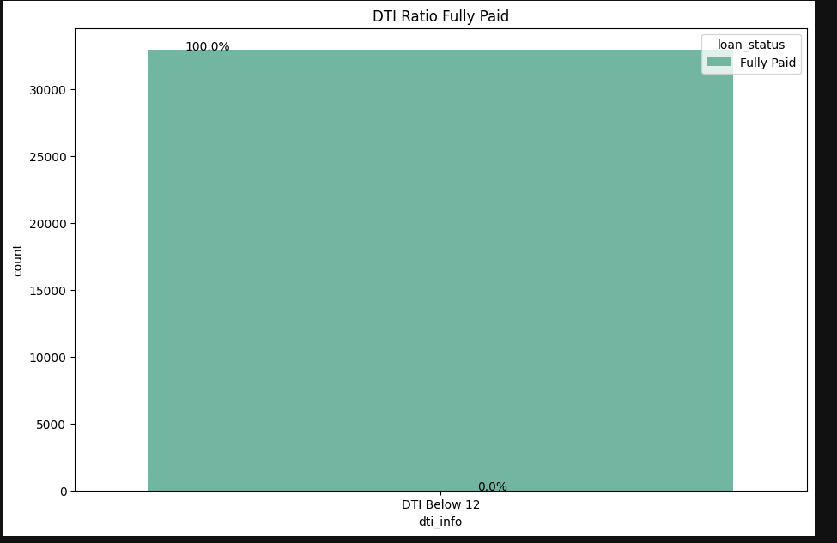
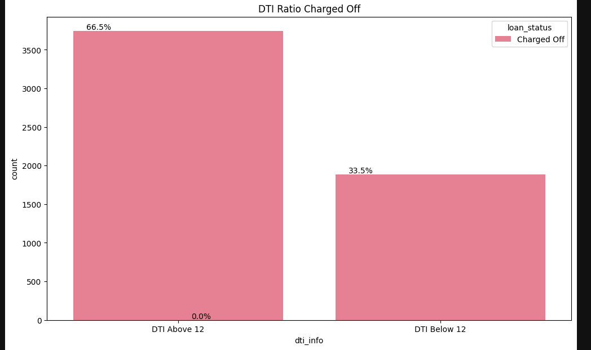
Findings of Loan Default
Insights from ‘Debt to Income Ratio’ - It has been observed that the number of defaults increases when the 'Debt to Income ratio' exceeds 12%

Slide 8
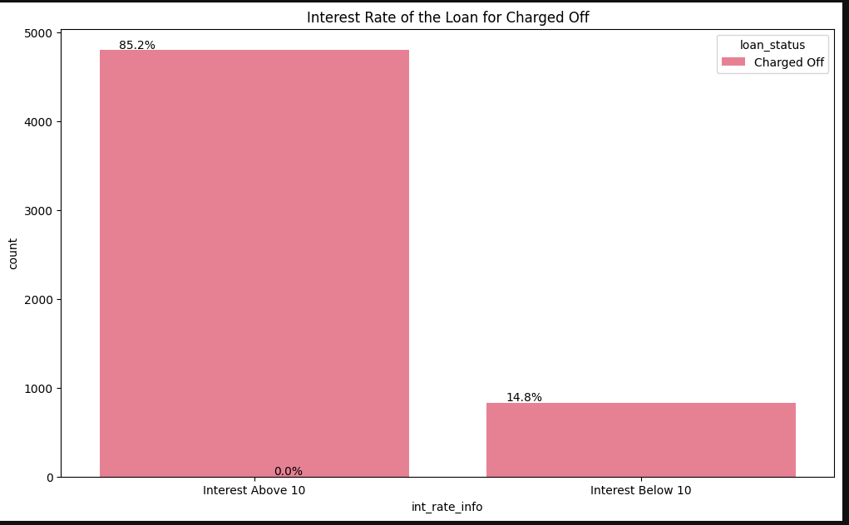
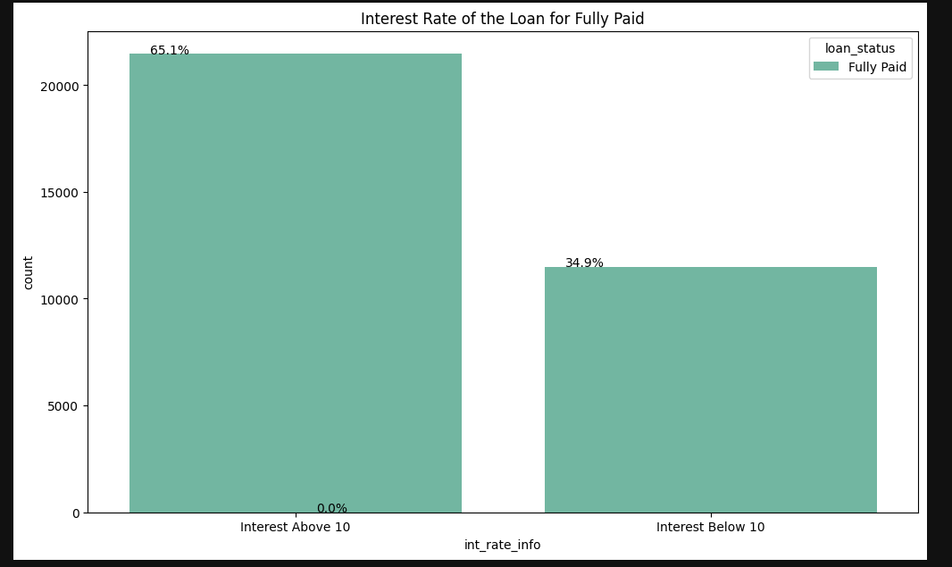
Findings of Loan Default
Insights from ‘Interest Rate’ - It has been observed that the number of defaults increases when the 'Interest Rate' exceeds 10%

Slide 9
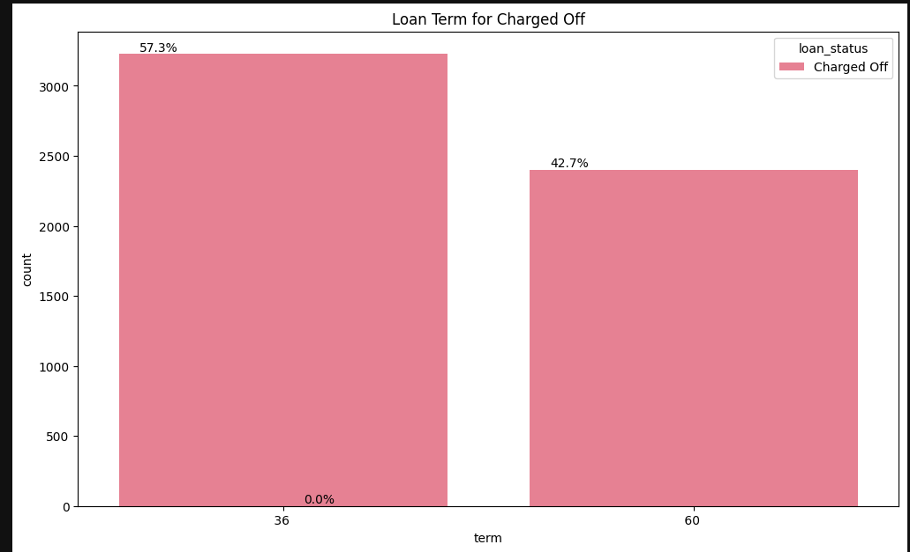
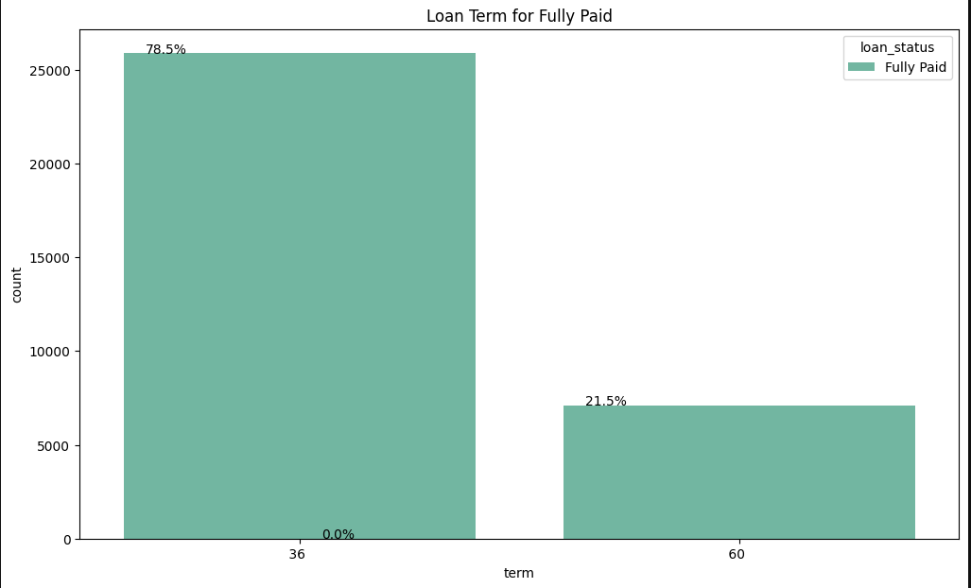
Findings of Loan Default
Insights from ‘Term’ - It has been observed that the number of defaults increases when the ‘Term' is 60 months

Slide 10
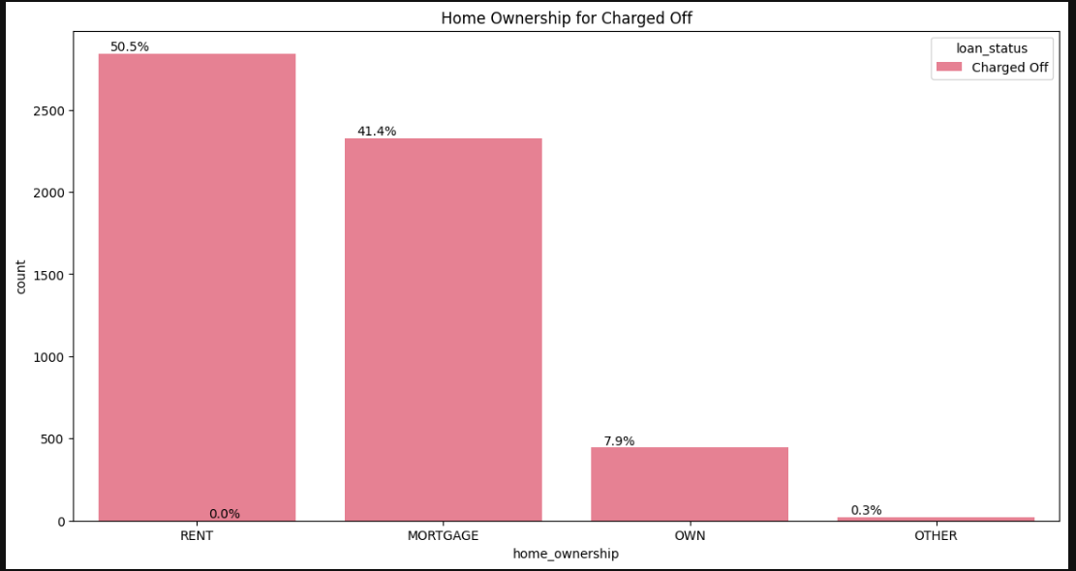
Findings of Loan Default
Insights from ‘Home Ownership’ - It has been observed that the number of defaults increases when the home is rented by the borrower

Slide 11
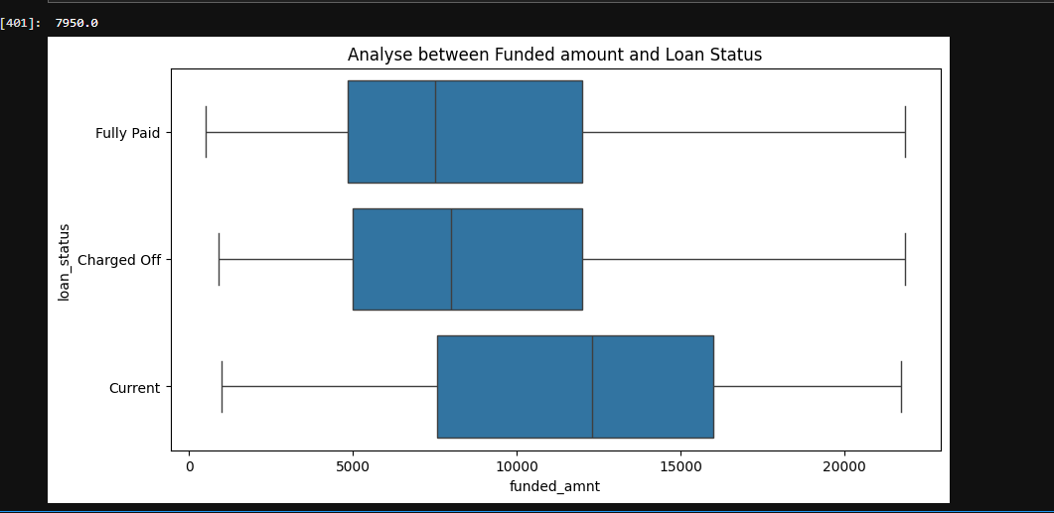
Findings of Loan Default
Relationship between ‘Funded Amount’ & ‘Loan Status’ - The median funded amount is slightly on the higher side for charged-off loans. This also means that when the above factors combine with higher loan funded amounts, it could lead to a default.

Slide 12
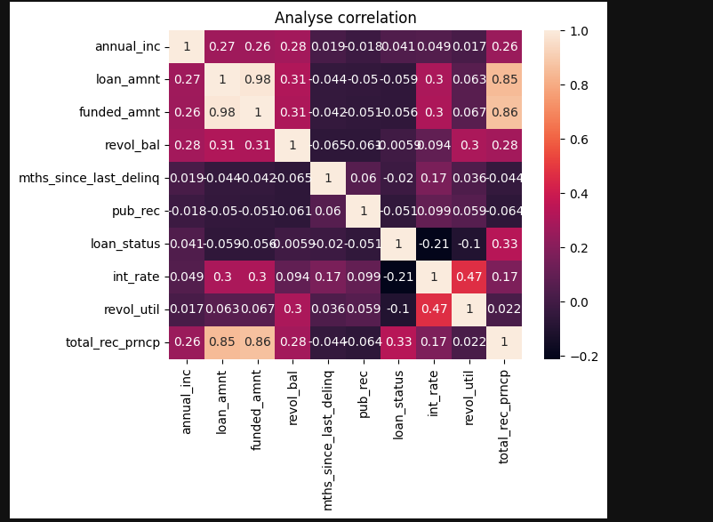
Findings of Loan Default
Heat Map showing the correlations between different fields

Slide 13
Key Findings
Borrowers with the following traits are more likely to default
The 'Revolving Line Utilization Rate' exceeds 50%
The 'Debt to Income ratio' exceeds 12%
When the loan has the following features, the number of defaults increases
the 'Interest Rate' exceeds 10%
the ‘Term' is 60 months
the home is rented by the borrower
A borrower with higher ‘Revolving Line Utilization Rate’ and ‘DTI’ ratio is likely to default when they are funded with higher loan amount or with higher interest rate or with higher term

Slide 14
Recommendations
Target for borrowers with lower 'Revolving Line Utilization Rate’
Target for borrowers with lower 'Debt to Income ratio'
Borrowers with higher ‘'Revolving Line Utilization Rate’ or 'Debt to Income ratio' shall not be funded with higher loan amounts
Borrowers with higher ‘'Revolving Line Utilization Rate’ or 'Debt to Income ratio' shall not be funded with the ‘Term’ of 60 months
Borrowers with higher ‘'Revolving Line Utilization Rate’ or 'Debt to Income ratio' shall not be funded when their home is a rented one

Slide 15
Thank You

